Slide 1
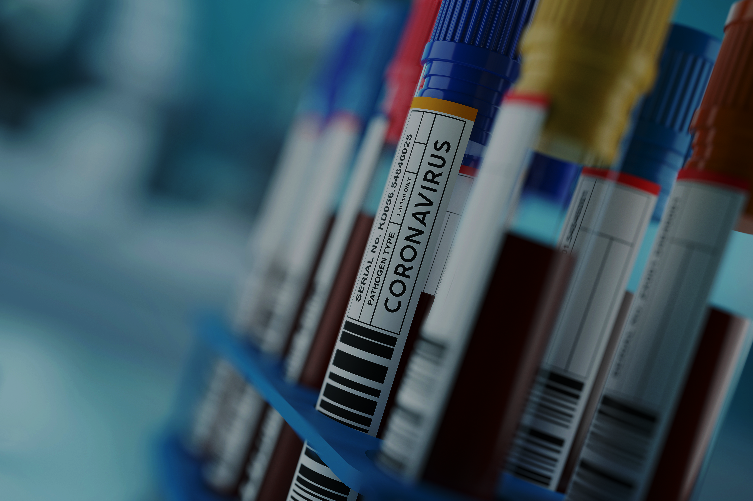
COVID 19 - Analysis
~ by Knight Coders
Team Members
Lovin Raphial Dongre
Yashodip Kamble
Prasad B. Bari
Divyani Mendhe

Slide 2
Introduction:
COVID-19 emerged as a global crisis that deeply impacted health, society and the economy.
India faced multiple waves, each showing sharp changes in cases, deaths and recoveries.
This project analyzes India’s COVID-19 data to uncover clear patterns and trends. It focuses on cases, testing, vaccination progress and the overall economic impact.
The goal is to understand how India responded and how the situation evolved over time. Visual insights and data-driven analysis help present a complete picture of the pandemic’s journey.

Slide 3
OBJECTIVE:
To analyze trends in COVID-19 cases, recoveries, and deaths in India.
To study the impact of testing and vaccination on the spread of the virus.
To evaluate how India’s response changed over time.
To present insights through clear visualizations and data-driven findings.

Slide 4
Stack Overview :
Power BI : Builds the data model and creates the interactive dashboard.
Creating a date table and relationships
Building calculated measures (KPIs)
Excel :
Cleaning and formatting daily case & vaccination data

Slide 5
Guesstimation
Case 1 : Missing Data
Problem: Data is in Between 2020-2021
Missing Data for Year 2022-2023
According to Data ,
2020 – 12 M Confirmed Cases
2021 – 22 M Confirmed Cases
Baseline :
For Year 2022, Confirmed Cases ≈ 40 % 0f 2021
- 22 M * 0.40 = 8.8 M
For Year 2023, Confirmed Cases ≈ 10 % of 2021
- 22 M * 0.10 = 2.2 M
(2020+2021+2022+2023) = ≈ 43 M Confirmed Cases in India

Slide 6
We Consider 40 % of 2021 for 2022,
After Feb 2022, Cases Dropped to low level
+ Vaccination Impact
We Consider 10 % of 2021 for 2023,
cases Stayed low
No Major Wave
WHO declared India in endemic transition phase

Slide 7
Guesstimation For Vaccination
Case 1 : Data from Feb 2021 – Sept 2021
According to Data ,
Feb 2021 to Sept 2021 – 513 M Total Doses Administrated
Calculation :
Remaining Months For 2021 :
- 513 M * 2 = 1026 M ≈ 1.03 B
For Year 2022, Total Doses ≈ 40 % of 2021
- 1.03 M * 0.40 = 512 M
For Year 2022, Total Doses ≈ 10 % of 2021
- 1.03 M * 0.10 = 128 M
(2021+2022+2023) = ≈ 1.9 B Doses Administrated in India

Slide 8
We Consider 40 % of 2021 for 2022,
Only teen & boosters vaccination occurred after more adults. Where Fully vaccination in 2021
We Consider 10 % of 2021 for 2023,
WHO declared India in endemic transition phase

Slide 9
Key Insights:
Overall Covid-19 Impact
Dashboard shows cases, recoveries, deaths, and vaccination trends in India.
Highlights national trends, state patterns, and vaccination impact.
Daily Trends
Cases spike during waves; recoveries follow after peaks.
Daily deaths mirror case spikes, showing healthcare pressure.
State-Level Analysis
Highest cases/deaths: Maharashtra, Kerala, Karnataka, Tamil Nadu, Uttar Pradesh.
Smaller states/UTs had fewer cases.
Active cases declined steadily after mid-2021 with vaccination progress.
Vaccination Insights
Increased vaccinations linked to decline in daily cases.
Active cases fell steadily as vaccination progressed.

Slide 10
Conclusion:
The analysis combines cases, vaccinations, and state-wise performance to give a clear overall view of the COVID-19 situation. The stacked visuals highlight key trends and factors driving changes over time. Interactive slicers make exploration easy by month, state, and dose type. Overall, the dashboard delivers a simple, insightful summary that supports quick understanding and informed decisions.

Slide 11
Thank You

